Slide 1

Artificial Intelligence in Financial Risk Management
Group 11
Team Members
Vamsi Sattenapalli
Manasa Swetha Tiramareddy
Manoj Naidu Arasada

Slide 2

Agenda
Introduction
Case Study Description
AI in Financial Services
Challenges in AI Adoption
Predictive Analytics for Risk Management
Data Challenges
Conclusion
Future Outlook

Slide 3

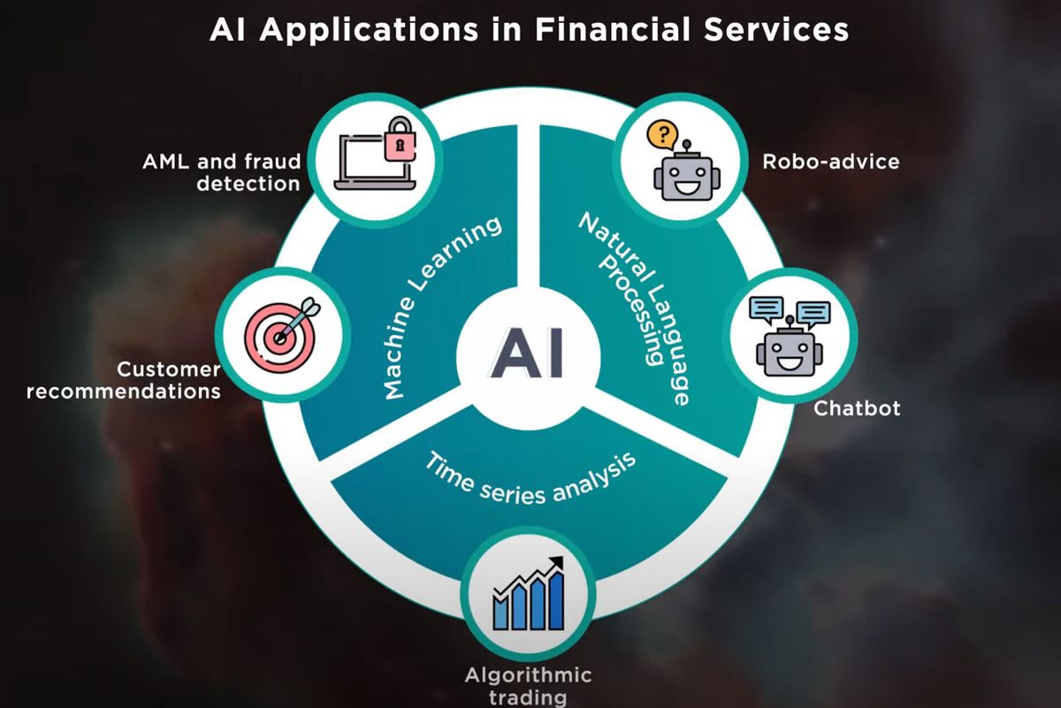
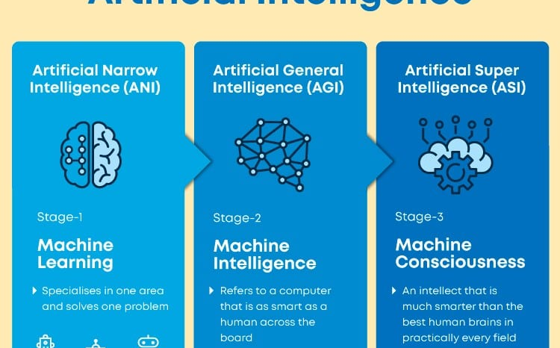
Introduction
Artificial Intelligence (AI) is revolutionizing the financial services industry, reshaping how institutions manage, invest, and protect finances.
Relevance and Importance: AI in financial risk management is crucial for optimizing decision-making, automating tasks, and adapting to evolving market conditions.
It offers enhanced efficiency, risk mitigation, and personalized services.
Changing Landscape: The financial sector is witnessing a significant shift due to AI, as it empowers institutions to deliver innovative solutions, including robo-advisors and proactive risk management.

Slide 4
Case Study Description
Introducing the Case Study: In this case study, we delve into a real-world scenario to explore the practical application of AI in financial risk management. The case study presents a concrete example of how AI is being utilized to address the challenges and opportunities discussed earlier.
Relevance to the Topic: This case study provides a tangible illustration of how financial institutions can harness AI's power to optimize risk management processes. It exemplifies the importance of predictive analytics, data quality, and regulatory compliance in a real-world context.
Main Goal of the Investigation: The primary goal of this case study is to demonstrate how AI greatly enhances risk management procedures in the financial sector. We aim to showcase how AI, through its capacity to analyze extensive data and uncover hidden patterns, can help financial institutions make more informed judgments, proactively manage risks, and improve overall financial stability. This case study serves as a practical roadmap for financial institutions looking to leverage AI effectively.

Slide 5
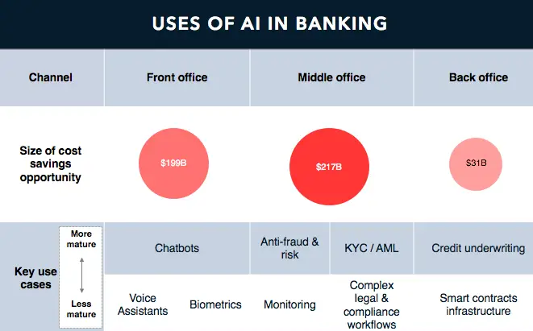
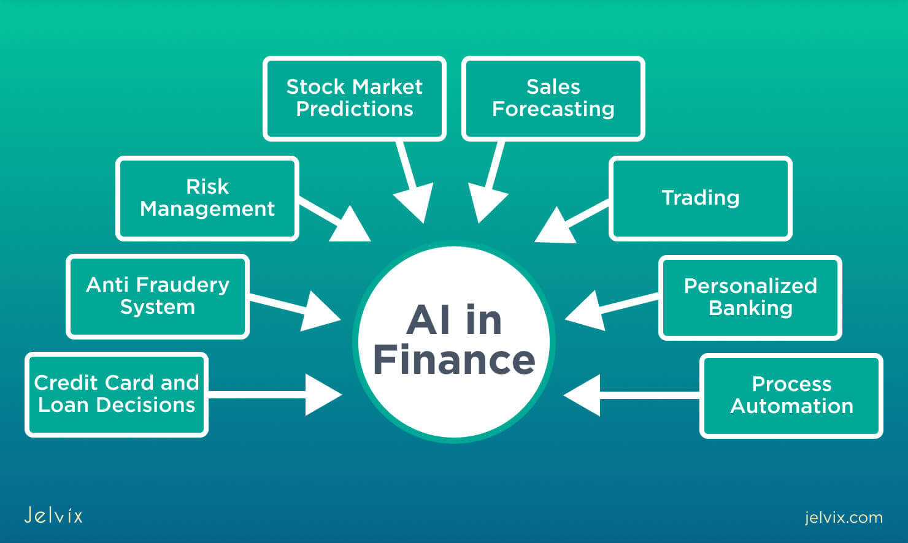
AI in Financial Services
Transformative Role: AI's transformative role in financial services extends beyond efficiency gains. It revolutionizes decision-making, risk management, and adaptability, showcasing its potential to redefine the industry.
Operational Efficiency: AI-driven automation optimizes back-office operations, reducing costs, and minimizing errors. This enables financial institutions to reallocate resources to more value-added tasks.
Customer Engagement: AI-driven chatbots and virtual assistants are enhancing customer engagement by providing 24/7 support, answering queries, and enabling self-service options, leading to improved customer satisfaction.
Tailored Investment Services: AI-powered robo-advisors are disrupting the investment sector, offering tailored investment strategies and portfolio management services to a broader range of customers.
Fraud Detection: AI is a potent tool in fraud detection, monitoring transactions in real-time to identify unusual patterns and potential fraud, thereby safeguarding financial assets.
CONTD…

Slide 6
Credit Risk Assessment: AI-driven credit scoring models use a wide range of data sources to evaluate borrowers' creditworthiness more accurately, reducing default risks.
Algorithmic Trading: Financial institutions use AI algorithms for high-frequency trading, optimizing investment strategies, and responding to market changes in real-time.
Insurance Underwriting: In insurance, AI automates underwriting processes by evaluating policy risks and determining appropriate coverage, which speeds up policy issuance and improves accuracy.
Claims Processing: AI streamlines claims processing by automating data extraction from various documents, expediting claims approval, and enhancing the overall claims experience for customers.
Regulatory Compliance: AI assists financial institutions in meeting regulatory requirements by automating data reporting and ensuring adherence to complex compliance rules.
Market Analysis: AI-powered analytics help financial institutions gain insights from vast amounts of market data, enabling them to make more informed investment decisions and manage risk effectively.

Slide 7
Benefits of AI in Financial Services
Enhanced Efficiency: AI enhances efficiency by automating tasks like data entry and document processing. For example, customer service chatbots handle routine queries, making operations faster and more precise.
Risk Mitigation: AI, through predictive analytics, identifies potential risks by analyzing historical data and market trends. This proactive approach helps financial institutions take preventative action to lower risk exposure.
Personalized Services: AI enables the delivery of highly personalized services. Machine learning algorithms can analyze customer data and behavior to provide tailored product recommendations.
Real-Time Decision Making: AI processes vast volumes of data in real time, allowing financial institutions to make quick and data-driven decisions.
Improved Customer Experience: AI-driven virtual assistants and chatbots provide 24/7 customer support. Customers can get immediate responses to inquiries, enhancing their overall experience.

Slide 8
Fraud Detection and Prevention: AI detects unusual patterns and anomalies in financial transactions, helping to identify and prevent fraudulent activities.
Cost Reduction: Automation of routine tasks reduces operational costs and the risk of human errors.
Scalability: AI systems can handle a large volume of data and tasks, making it easier for financial institutions to scale their operations.
Compliance and Regulatory Assistance: AI assists financial institutions in ensuring compliance with ever-evolving regulations. AI systems can track and report on compliance issues, reducing the risk of penalties.
Market Analysis and Investment Strategy: AI provides insights from vast amounts of market data, helping financial institutions make informed investment decisions.

Slide 9
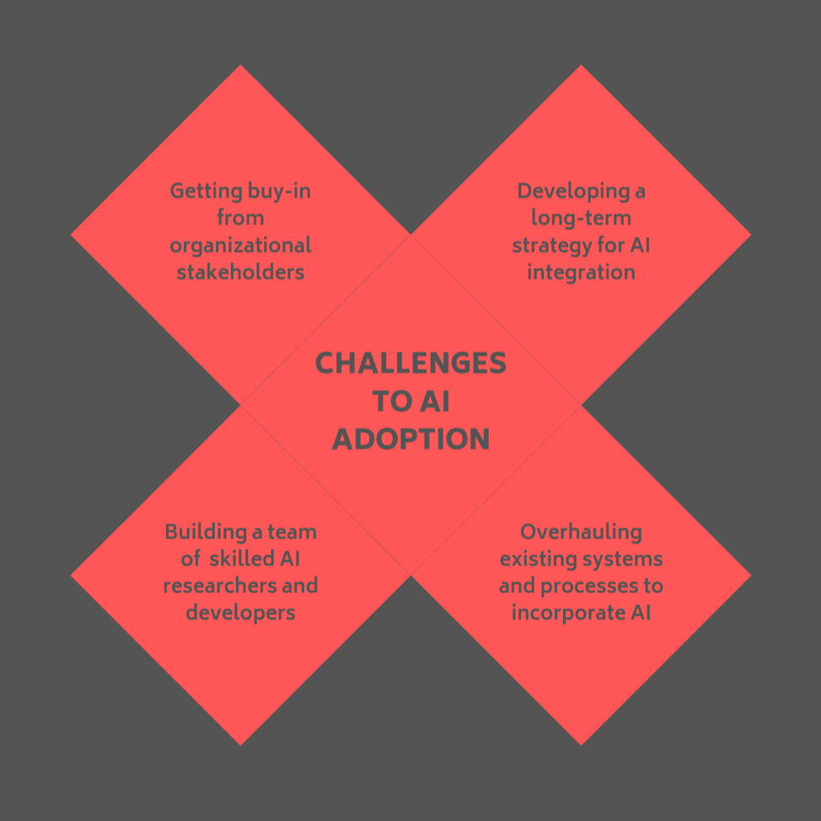
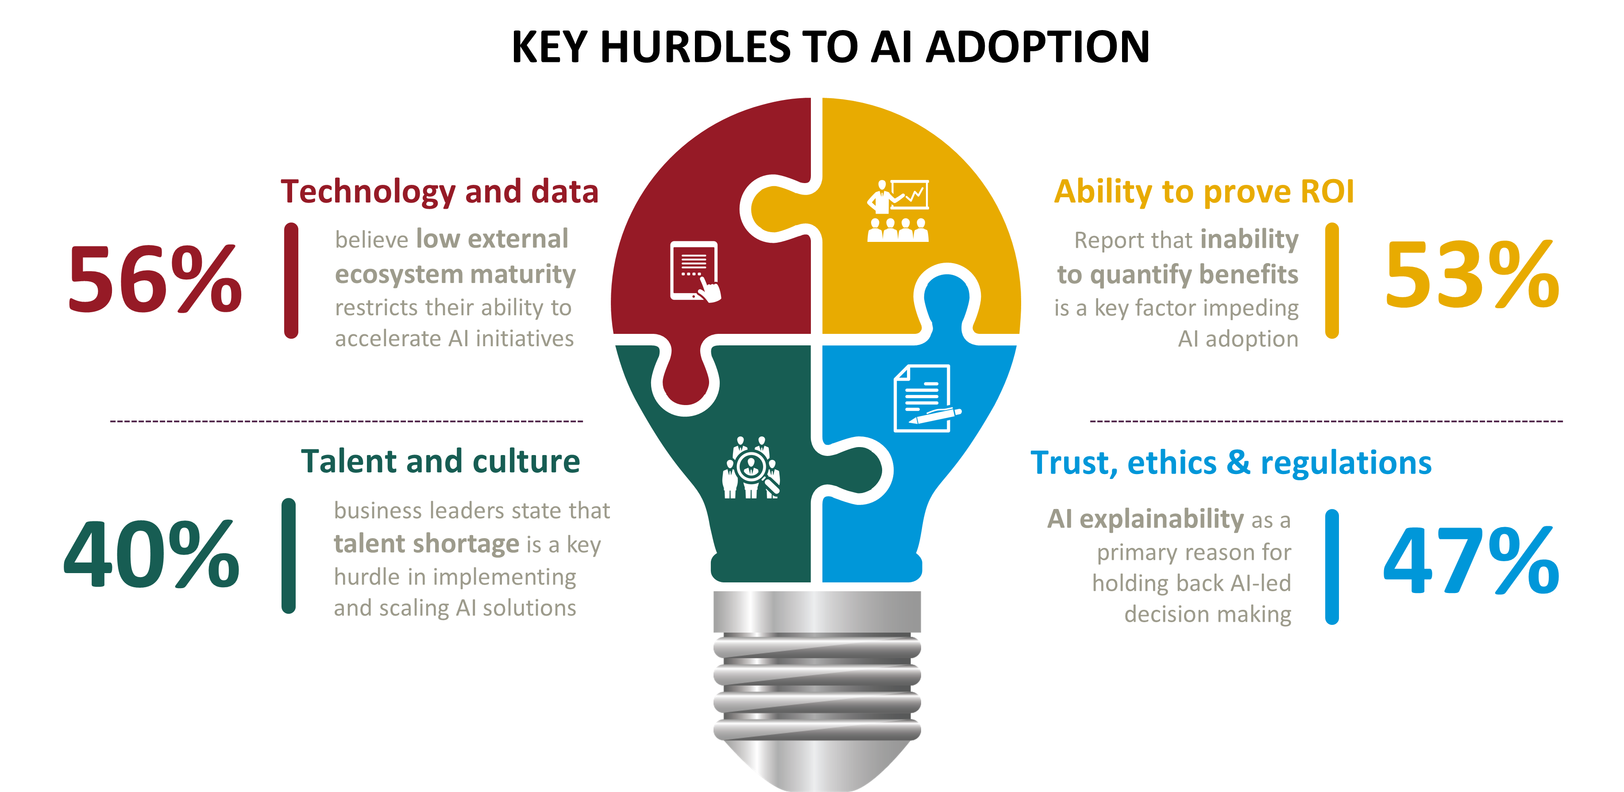
Challenges in AI Adoption
Data Quality: Ensuring data accuracy is crucial for unbiased AI results.
Data Quantity: Access to large and diverse datasets is essential for accurate predictions and pattern recognition.
AI Risks: Managing risks like algorithmic biases, security vulnerabilities, and decision-making errors.
Regulatory Concerns: Navigating complex regulations, including data privacy rules like GDPR, is crucial.
Algorithmic Accountability: Maintaining transparency in AI-driven decisions is vital for trust and accountability.

Slide 10
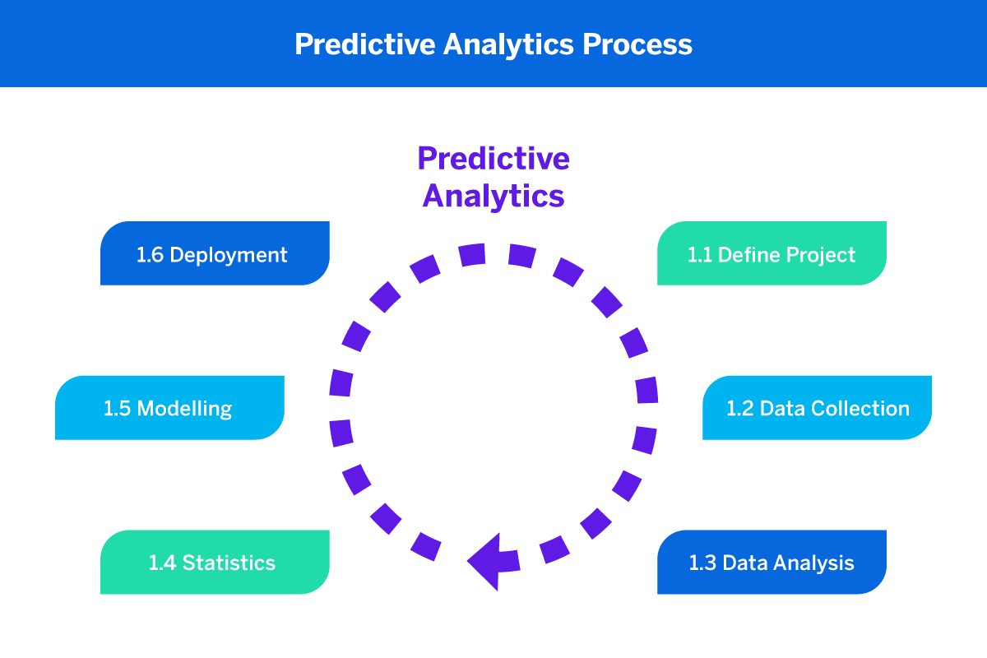
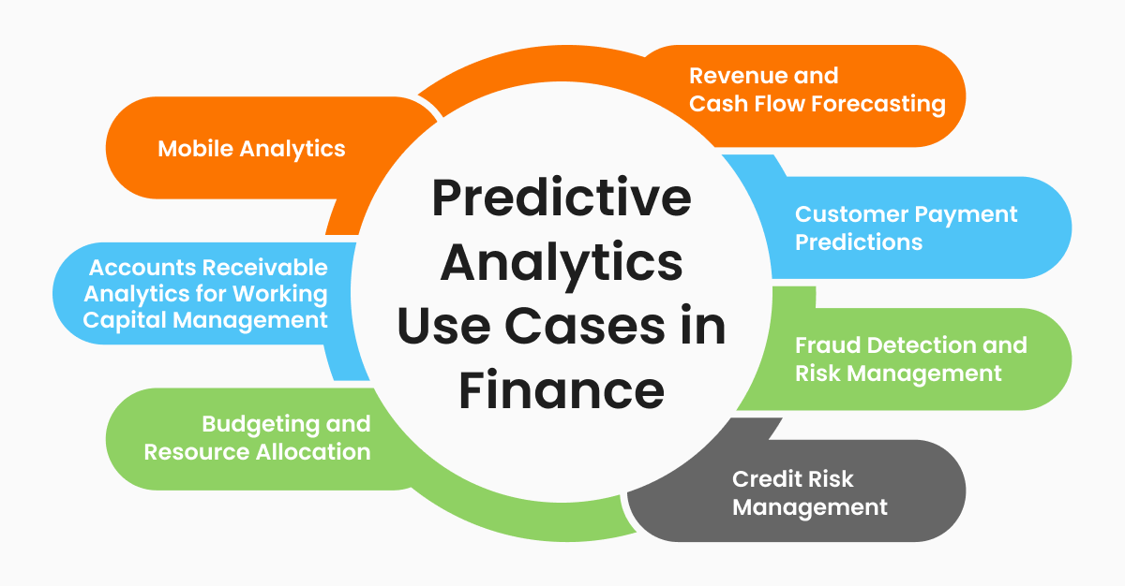
Predictive Analytics for Risk Management
Predictive Analytics with AI: AI-driven predictive analytics forecasts future events using historical data and advanced algorithms.
Identifying Potential Risks: AI and predictive analytics analyze historical data and market trends to detect risks, like fraud and market irregularities.
Proactive Risk Management: This approach anticipates and prevents risks, reducing exposure and improving financial stability.
Improved Decision-Making: AI offers data-driven insights for better decision-making in investments and risk assessment.
Enhanced Financial Stability: Proactive risk management through predictive analytics leads to a more secure financial environment by addressing risks before they escalate.

Slide 11
The adoption of Artificial Intelligence in financial risk management faces hurdles in data quality, AI risks, and regulatory compliance, which need to be effectively addressed for the successful implementation of AI in the financial sector
'Artifact refinement involves enhancing AI-driven risk models, reports, and other outputs to ensure they are accurate, clear, and aligned with the goals of improving financial stability and risk mitigation
Existing research underscores AI's effectiveness in predicting financial risks but highlights challenges in data quality, regulatory compliance, and fairness. This calls for a balanced approach to harness AI's potential in risk management while addressing these issues
Process Flow
In our 'AI in Financial Risk Management' case study, the intervention and artifact review assess the impact and quality of AI implementations and associated artifacts, ensuring they align with the goals of risk management.
Data analysis involves collecting, cleaning, and exploring data to extract insights. It includes statistical testing, modeling, and visualizations to make informed decisions and draw conclusions from the data
Creating artifacts involves setting objectives, collecting data, choosing a format, designing and creating the artifact, structuring content, using visual elements, reviewing and editing, interpreting data if relevant, adding citations, seeking feedback, finalizing, and distributing to the intended audience

Slide 12
Conclusion
AI helps finance by making things accurate and saving time, but it can be unfair and secretive.
It can make loans easier to get and improve banks' choices, but it might also exclude people and let big companies dominate.
So, we must use AI carefully, ensuring it's ethical, transparent, and accountable, with clear rules to keep finance ethical and understandable.

Slide 13
AI in financial risk assessment is a big deal. It makes things more accurate, saves time, and helps us spot financial problems early. But we must be careful because it can also create unfairness and hide how decisions are made.
On the bright side, AI can make it easier for people to get loans and improve how markets work. It can also help banks make better choices and reduce big financial problems.
But there's a downside too. AI can sometimes treat people unfairly, and we might not know why. It could also leave some people out. It might even lead to big companies dominating finance.
So, we need to be careful. We must make sure AI is ethical, clear, and that people can be responsible for it. This means checking for unfairness, being open about how AI works, and making sure someone is in charge.
In the end, AI can be great for finance, but we need to use it the right way, with rules to keep things ethical and clear.

Slide 14

Questions?

Slide 15

Thank You

